Slide 1
Data Analysis Using SQL
Pizza Hut Sales

Slide 2
Problem Statement
The objective of this project is to analyze Pizza Hut sales data to extract meaningful business insights. The dataset contains information about orders, pizza types, quantities, pricing, and timestamps.
The goal is to:
Understand customer ordering behavior
Identify top-performing products
Analyze revenue trends
Support data-driven decision-making for business growth

Slide 3
Objectives
Calculate total orders and revenue
Identify best-selling pizzas and categories
Analyze order patterns by time and date
Evaluate revenue contribution by category
Generate insights for business optimization

Slide 4
Tools & Technologies Used
SQL Server
T-SQL
Data Cleaning Techniques
Aggregations & Window Functions
Joins & Subqueries

Slide 5
Dataset Description
The dataset consists of the following four tables:
Orders
order_id
date
time
Order Details
order_details_id
order_id
pizza_id
quantity
Pizzas
pizza_id
pizza_type_id
size
price
Pizza Type
pizza_type_id
name
category

Slide 6
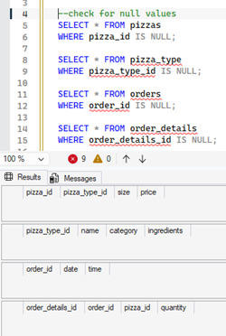
Data Cleaning Process
Before analysis, the dataset was cleaned to ensure accuracy:
1. Null Value Check
Verified all primary key columns
--check for null values
SELECT * FROM pizzas WHERE pizza_id IS NULL;
SELECT * FROM pizza_type WHERE pizza_type_id IS NULL;
SELECT * FROM orders WHERE order_id IS NULL;
SELECT * FROM order_details WHERE order_details_id IS NULL;
No null values found in ID columns.

Slide 7
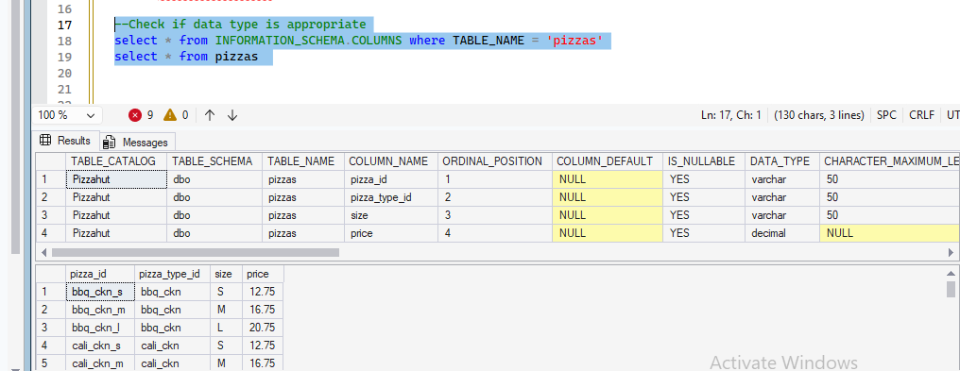
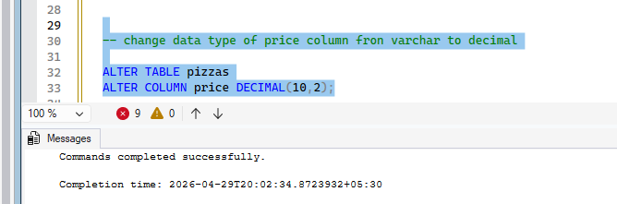
Data Cleaning Process
2. Data Type Correction
Check if data type is appropriate
In ‘Pizzas’ table converted price column from
VARCHAR → DECIMAL(10,2)
-- Verified column structure using INFORMATION_SCHEMA
select * from INFORMATION_SCHEMA.COLUMNS where TABLE_NAME = 'pizzas‘ select * from pizzas;
-- change data type of price column from varchar to decimal
ALTER TABLE pizzas
ALTER COLUMN price DECIMAL(10,2);

Slide 8
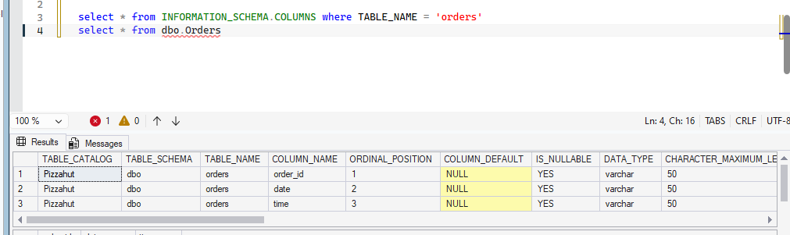
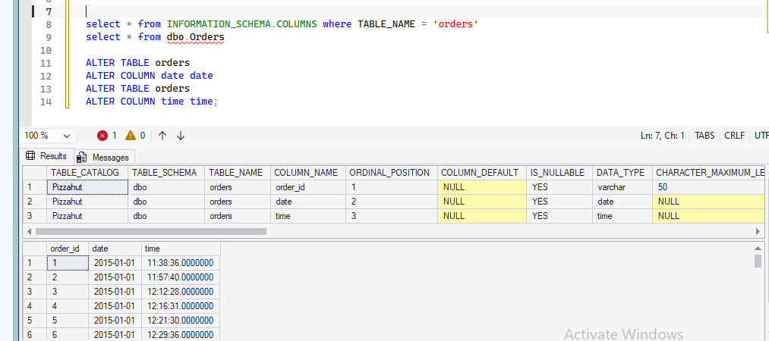
Data Cleaning Process
2. Data Type Correction
Check ‘Orders’ table and set appropriate data type for date and time column.
-- Verified column structure using INFORMATION_SCHEMA
select * from INFORMATION_SCHEMA.COLUMNS where TABLE_NAME = 'orders‘
select * from Orders
--Alter data type for date and time column
ALTER TABLE orders ALTER COLUMN date date
ALTER TABLE orders ALTER COLUMN time time;
In ‘Orders’ table converted:
Date column from VARCHAR → DATE
Time column from VARCHAR → TIME

Slide 9
Business Impact
Helps identify high-demand products
Supports pricing and promotion strategies
Improves operational efficiency
Enables data-driven decision making

Slide 10
Pizza Sales Analysis Using SQL
Basic Analysis
Total number of orders
Total revenue generated
Highest-priced pizza
Most common pizza size
Top 5 most ordered pizzas
Total quantity sold by category
Category-wise pizza distribution
Intermediate to Advanced Analysis
Orders distribution by hour
Average pizzas ordered per day
Top 3 pizzas based on revenue
Revenue contribution (%) by category
Cumulative revenue over time
Top 3 pizzas per category (using ranking)

Slide 11
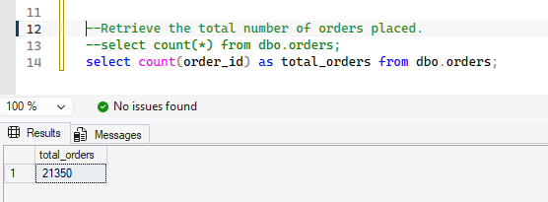
Pizza Sales Analysis Using SQL
1. Retrieve the total number of orders placed.
SQL QUERIES
--Retrieve the total number of orders placed.
--select count(*) from dbo.orders;
select count(order_id) as total_orders from dbo.orders;
The total number of orders placed are 21350.

Slide 12
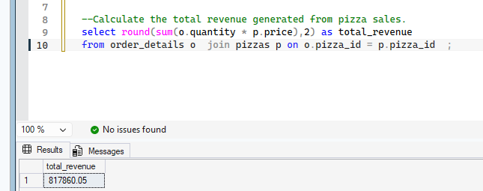
Pizza Sales Analysis Using SQL
2. Calculate the total revenue generated from pizza sales.
SQL QUERIES
--Calculate the total revenue generated from pizza sales.
select round(sum(o.quantity * p.price),2) as total_revenue
from order_details o join pizzas p on o.pizza_id = p.pizza_id ;
The total revenue generated from pizza sales is ₹817860.05

Slide 13
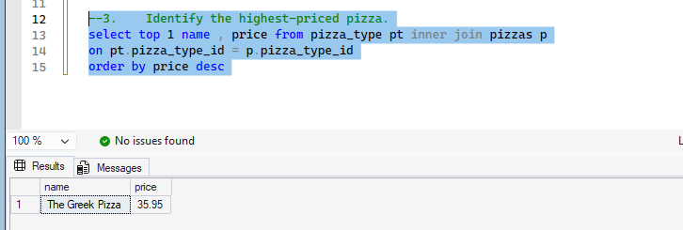
Pizza Sales Analysis Using SQL
3. Identify the highest-priced pizza.
SQL QUERIES
--Identify the highest-priced pizza.
select top 1
name ,
price
from pizza_type pt
inner join pizzas p
on pt.pizza_type_id = p.pizza_type_id
order by price desc
The highest-priced pizza is ‘The Greek Pizza’ with price ₹35.95

Slide 14
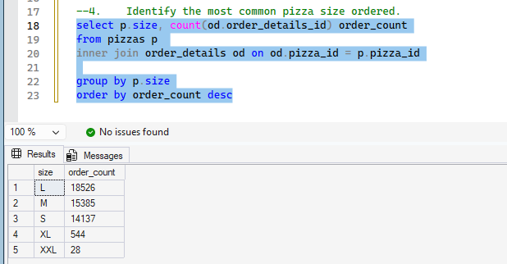
Pizza Sales Analysis Using SQL
4. Identify the most common pizza size ordered.
SQL QUERIES
--Identify the most common pizza size ordered.
select p.size, count(od.order_details_id) order_countfrom pizzas p
inner join order_details od
on od.pizza_id = p.pizza_id
group by p.size
order by order_count desc
The most common sized is ‘Large’ sized pizza with 18526 orders.

Slide 15
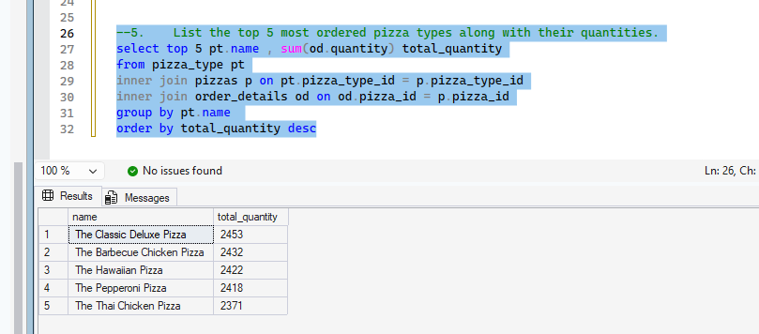
Pizza Sales Analysis Using SQL
5. List the top 5 most ordered pizza types along with their quantities.
SQL QUERIES
--List the top 5 most ordered pizza types along with their quantities.
select top 5 pt.name ,
sum(od.quantity) total_quantity
from pizza_type pt
inner join pizzas p
on pt.pizza_type_id = p.pizza_type_id
inner join order_details od on od.pizza_id = p.pizza_id
group by pt.name
order by total_quantity desc
The top most ordered pizza type are:

Slide 16
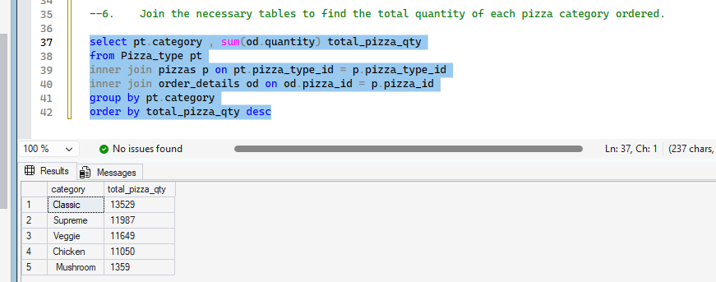
Pizza Sales Analysis Using SQL
6. Join the necessary tables to find the total quantity of each pizza category ordered.
SQL QUERIES
--Join the necessary tables to find the total quantity of each pizza category ordered.
select pt.category ,
sum(od.quantity) total_pizza_qty
from Pizza_type pt
inner join pizzas p
on pt.pizza_type_id = p.pizza_type_id
inner join order_details od
on od.pizza_id = p.pizza_id
group by pt.category
order by total_pizza_qty desc
The total quantity of each pizza category ordered:

Slide 17
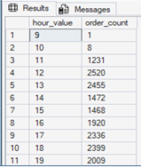
Pizza Sales Analysis Using SQL
7. Determine the distribution of orders by hour of the day.
SQL QUERIES
--Determine the distribution of orders by hour of the day.
select
datepart(hour,o.time) hour_value,
count(o.order_id) as order_count
from orders o
group by datepart(hour,o.time)
order by hour_value
The distribution of orders by hour of the day.

Slide 18
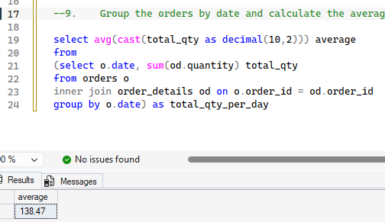
Pizza Sales Analysis Using SQL
9. Group the orders by date and calculate the average number of pizzas ordered per day.
SQL QUERIES
--Group the orders by date and calculate the average number of pizzas ordered per day.
select
avg(cast(total_qty as decimal(10,2))) average
from (
select o.date, sum(od.quantity) total_qty
from orders o
inner join order_details od
on o.order_id = od.order_id
group by o.date
) as total_qty_per_day
The average number of pizzas ordered per day is 138.47

Slide 19
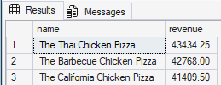
Pizza Sales Analysis Using SQL
10. Determine the top 3 most ordered pizza based on revenue.
SQL QUERIES
--Determine the top 3 most ordered pizza based on revenue.
select top 3 pt.name ,
sum(od.quantity * p.price) as revenue
from pizzas p
inner join order_details od
on p.pizza_id = od.pizza_id
inner join Pizza_type pt
on pt.pizza_type_id = p.pizza_type_id
group by pt.name
order by revenue desc
The top 3 most ordered pizza based on revenue are:
The Thai Chicken Pizza
The Barbecue Chicken Pizza
The California Chicken Pizza

Slide 20
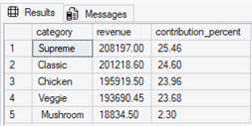
Pizza Sales Analysis Using SQL
11. Calculate the percentage contribution of each pizza type to total revenue.
SQL QUERIES
select t.category, t.revenue,
CAST(revenue * 100.0 / total_revenue AS DECIMAL(10,2)) AS contribution_percent
from(
select
pt.category ,
sum(od.quantity * p.price) as revenue,
sum(sum(od.quantity * p.price)) over() as total_revenue
from pizzas p
inner join order_details od
on p.pizza_id = od.pizza_id
inner join Pizza_type pt
on pt.pizza_type_id = p.pizza_type_id
group by pt.category
) t
order by revenue desc
The percentage contribution of each pizza type to total revenue:

Slide 21
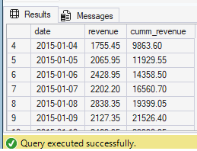
Pizza Sales Analysis Using SQL
12. Analyze the cumulative revenue generated over time.
SQL QUERIES
-- Analyze the cumulative revenue generated over time.
select t.date,t.revenue,
sum(t.revenue) over(order by t.date) as cumm_revenue
from
(select o.date,
sum( od.quantity * p.price) as revenue
from orders o
inner join order_details od on od.order_id = o.order_id
inner join pizzas p on p.pizza_id = od.pizza_id
group by o.date
) t
Below is the cumulative revenue generated over time :

Slide 22
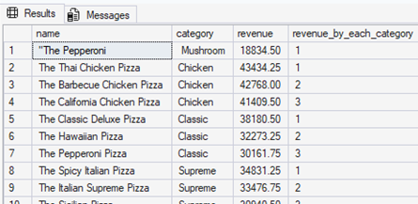
Pizza Sales Analysis Using SQL
13. Determine the top 3 most ordered pizza types based on revenue for each pizza category.
SQL QUERIES
select * from
(select t.name,t.category ,t.revenue,
rank() over(partition by category order by revenue desc) as revenue_by_each_category
from(
select pt.name, pt.category,
sum(od.quantity * p.price) as revenue
from orders o
inner join order_details od on od.order_id = o.order_id
inner join pizzas p on p.pizza_id = od.pizza_id
inner join Pizza_type pt on pt.pizza_type_id = p.pizza_type_id
group by pt.name, pt.category
)t
) t1
where revenue_by_each_category <= 3
Below are the top 3 most ordered pizza types based on revenue for each pizza category

Slide 23
Conclusion
This project demonstrates how SQL can be used to transform raw transactional data into actionable insights.
By analyzing sales trends, customer preferences, and revenue distribution, businesses can make informed strategic decisions.

Slide 24
Future Enhancements
Build Power BI dashboard for visualization
Add customer segmentation analysis
Forecast future sales using time-series models
Integrate real-time data pipelines

Slide 25
Thank you!

